Slide 1
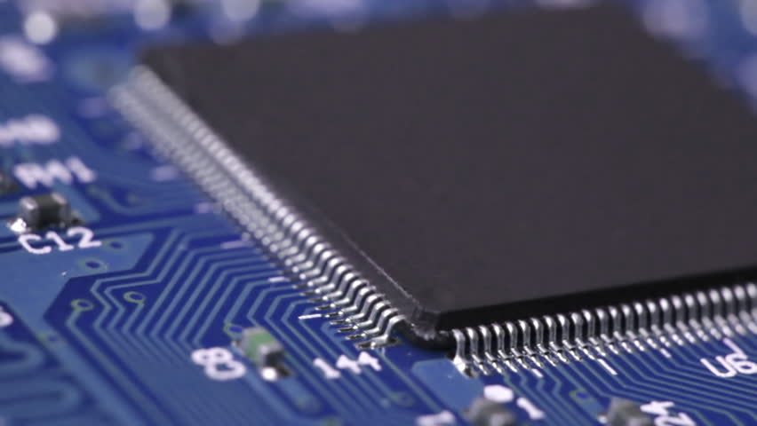
MICROCONTROLLER & ITS APPLICATIONS
(REVIEW - 2)

Slide 2
TEAM MEMBERS
Shubham Aniket - 18BEC2020
Samriddh Singh - 18BEC2029
Rahul Mahesh Awari – 18BEC2014
Swapnil Shekhar – 18BEC2016

Slide 3
Topic
RFID BASED CAR PARKING SYSTEM UISNG 8051 MICROCONTROLLER

Slide 4
Abstract
RFID based Car Parking System is a simple project that offers an efficient car parking management system with the help of RFID Technology. Car parking management in organizations and malls often consists of many tasks like issuing tokens, noting the check-in and checkout time, calculating fare and finally collecting the amount.
Car Parking creates a lot of chaos and mismanagement and hence this project will automate the process in a lot of ways.

Slide 5
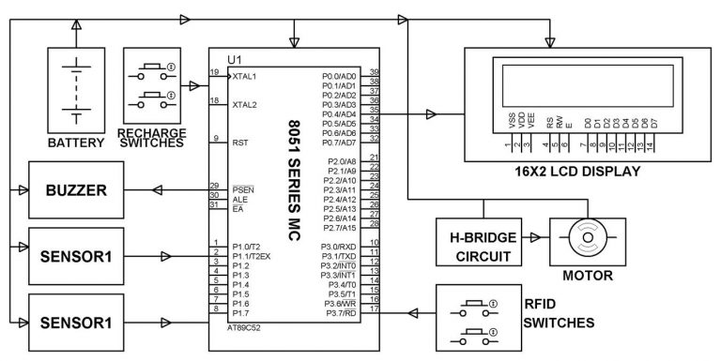
Block Diagram

Slide 6
Working
The project shows the design of an RFID based car parking system using 8051 microcontroller, in which only authorized personnel with valid RFID card are allowed access to parking.
When the ID card is detected by the reader, a unique card number is sent to the microcontroller.
If the card number is matched with saved number in microcontroller or database, the microcontroller will allow the car in order to park in the secured area.

Slide 7
Advantages & Application
RFID based Car Parking System is implemented in this project and can be used to eliminate the hassle of manual operation of parking system.
This system can help in reducing cost, increase in productivity and saves time.
Prepaid and postpaid cards can be integrated with the system for easy payment options.

Slide 8
CIRCUIT DIAGRAM

Slide 9
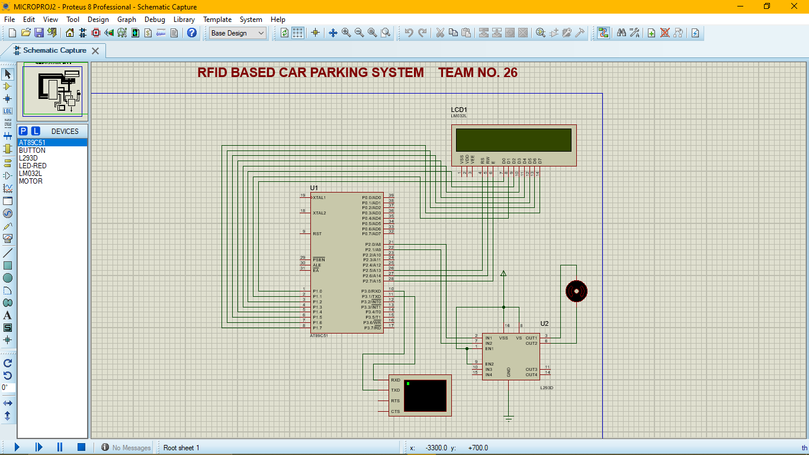

Slide 10
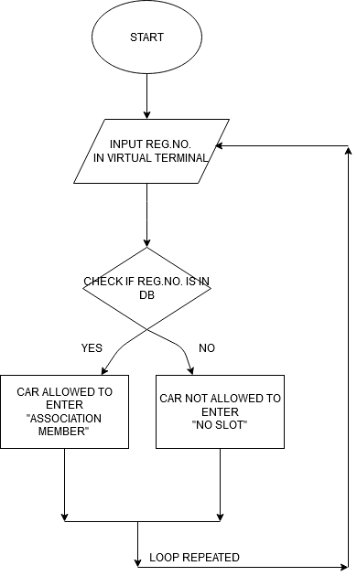

Slide 11
PROJECT CODE

Slide 12
#include<reg51.h>
/*Motor Connection Declaration*/
sbit doorp=P2^0; //Opening Motor Pin (P2.0) clockwise
sbit doorn=P2^1; //Closing Motor Pin (P2.1) anti-clockwise
/*LCD Connection Declaration*/
sbit rs=P2^5; //Register Select Pin (P2.5)
sbit rw=P2^6; //Read & write Pin (P2.6)
sbit en=P2^7; //Enable Pin (P2.7)
void lcddat(unsigned char); //Function to send data to LCD, character by character(1 byte size)
void lcdcmd(unsigned char); //Function to send command to LCD
void lcddis(unsigned char *); //Function to display string in LCD
void lcd_init(); //LCD initialization
void serial_init(); //Serial Initialization for serial communication b/w RFID reader & LCD
void check(); //Function to Check if reg. no. is present in database or not

Slide 13
/*Delay functions*/
void delay();
void mdelay();
unsigned char rfid[10],v1; //Variable declaration, rfid[10] is 1-D array of size 10
/* MAIN function declaration */
void main()
{
doorp=doorn=0; //Both the motors opening & closing is initialized to 0
serial_init(); //Serial Initialization function is called
lcd_init(); //LCD initialization function is called
lcddis("RFID BASED CAR");
lcdcmd(0xc0); //0xc0 forces cursor to the beginning of second line
lcddis("PARKING SYSTEM");
mdelay();
lcdcmd(0x01); //0x01 clears the LCD
lcddis("MADE BY");
lcdcmd(0xc0);

Slide 14
lcddis("TEAM 26");
mdelay();
while(1)
{
lcdcmd(0x01); //LCD is cleared
lcddis("SWIPE YOUR CARD");
//for loop is run for the no. of characters in the password one will enter
for(v1=0;v1<9;v1++)
{
while(RI==0); //wait untill data is received from rfid reader to 8051
//After data is received it is saved in the SBUF register
rfid[v1]=SBUF; //SBUF character is saved in rfid[v1]
RI=0; //RI is forced to 0 to allow next received chracter byte to be placed in SBUF
SBUF=rfid[v1]; //Re-Transmitting back to SBUF in order to see what we are typing
while(TI==0);
TI=0;
}

Slide 15
check(); //Check function is called
}
}
/*
Check Function
It matches the reg. no. entered in the terminal with one present here
*/
void check()
{
if(rfid[0]=='1'&&rfid[1]=='8'&&rfid[2]=='B'&&rfid[3]=='E'&&rfid[4]=='C'&&rfid[5]=='2'&&rfid[6]=='0'&&rfid[7]=='2'&&rfid[8]=='0')
{
lcdcmd(0x01); //0x01 clears the LCD contents
lcddis("ASSOCIATION MEMBER"); //String is displayed in the LCD
lcdcmd("0xc0"); //0xc0 forces the cursor to beginning of second line
lcddis("SHUBHAM ANIKET");
delay(); //Delay function is called

Slide 16
delay();
lcdcmd(0x01); //LCD is cleared
doorp=1;doorn=0; //Opening door is turned high
lcddis("DOOR OPENING");
lcdcmd(0xc0); //Forcing cursor to beginning of second line
lcddis("ALLOW INSIDE");
mdelay();
doorp=0;doorn=0; //Both the motors are now turned off
delay();
lcdcmd(0x01); //Clears the LCD
doorp=0;doorn=1; //Closing motor is turned high
lcddis("DOOR CLOSING");
mdelay();
doorp=0;doorn=0; //Both the motors are turned off again
}

Slide 17
else
{
lcdcmd(0x01); //LCD is cleared
lcddis("OUTSIDE PERSON");
lcdcmd(0xc0); //Forcing cursor to second line
lcddis("NO SLOT FOR YOU");
mdelay();
}
}
/*LCD initialization function*/
void lcd_init()
{
lcdcmd(0x38); //8-bit data initialization
lcdcmd(0x01); //Clear LCD Screen
lcdcmd(0x10); //Shift cursor position to right
lcdcmd(0x0c); //Display switch command to turn on display and turn off cursor
lcdcmd(0x80); //Sets the cursor to the beginng of first line
}

Slide 18
/*LCD command function*/
void lcdcmd(unsigned char val)
{
P1=val;
rs=0;
rw=0;
en=1;
delay();
en=0;
}
/*LCD Data Function*/
void lcddat(unsigned char val)
{
P1=val;
rs=1;
rw=0;
en=1;

Slide 19
delay();
en=0;
}
/*Delay Function in ms*/
void delay()
{
unsigned int v5;
for(v5=0;v5<6000;v5++);
}
/*LCD Display Function*/
void lcddis(unsigned char *s)
{
unsigned char w; //Temp. variable
for(w=0;s[w]!='\0';w++) //Sending character by character untill s[w] hits null character
{
lcddat(s[w]);
}
}

Slide 20
/*Serial Initialization Function*/
void serial_init()
{
SCON=0x50; //SCON value is loaded with 50H
TMOD=0x20; //Timer 1, Mode 2 selected
TH1=-3; //9600 baud rate
TR1=1; //Timer 1 is started
}
void mdelay()
{
unsigned int v6,v7;
for(v6=0;v6<2;v6++)
{
for(v7=0;v7<60000;v7++);
}
}

Slide 21
WORK DISTRIBUTION
Shubham Aniket & Rahul Awari Code
Samriddh Singh Proteus Circuit & Simulation
Swapnil Shekhar Documentation

Slide 22
References
Microcontroller Based Car Parking Automation.
International Journal of Engineering Research in Computer Science and Engineering.
Link -https://www.technoarete.org/common_abstract/pdf/IJERCSE/v4/i6/Ext_03295.pdf

